Slide 1
Photo Project I
By Ina Lalic

Slide 2
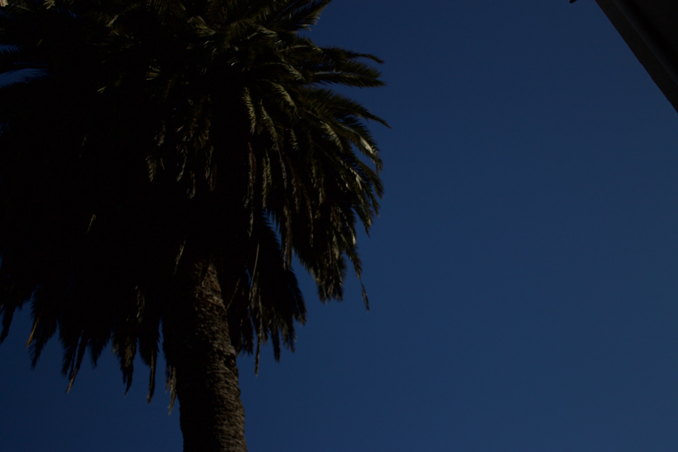
Underexposed photo

Slide 3

Overexposed photo

Slide 4
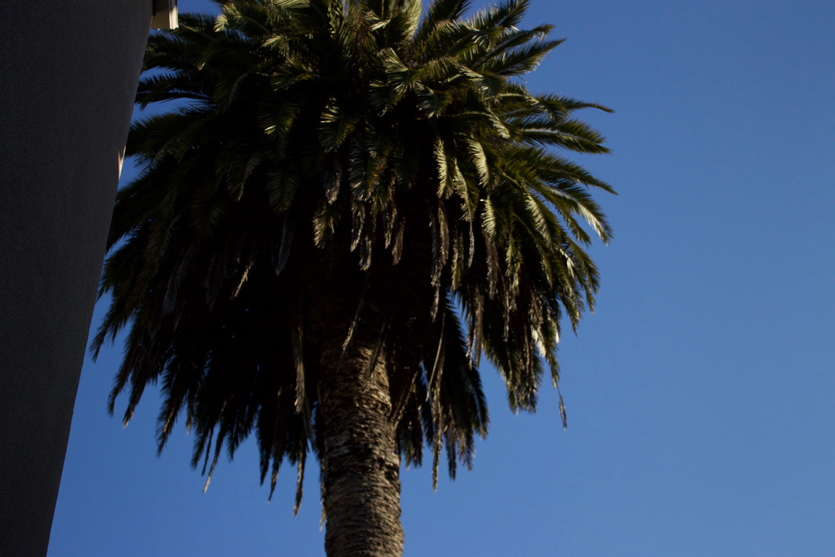
Properly exposed photo

Slide 5
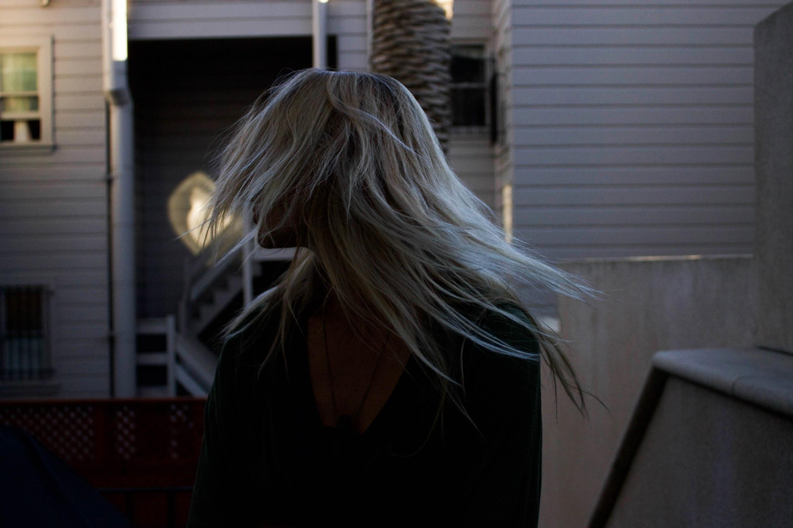
High Shutter Speed

Slide 6

Low Shutter Speed

Slide 7

Shutter Speed/Movement Experiment

Slide 8
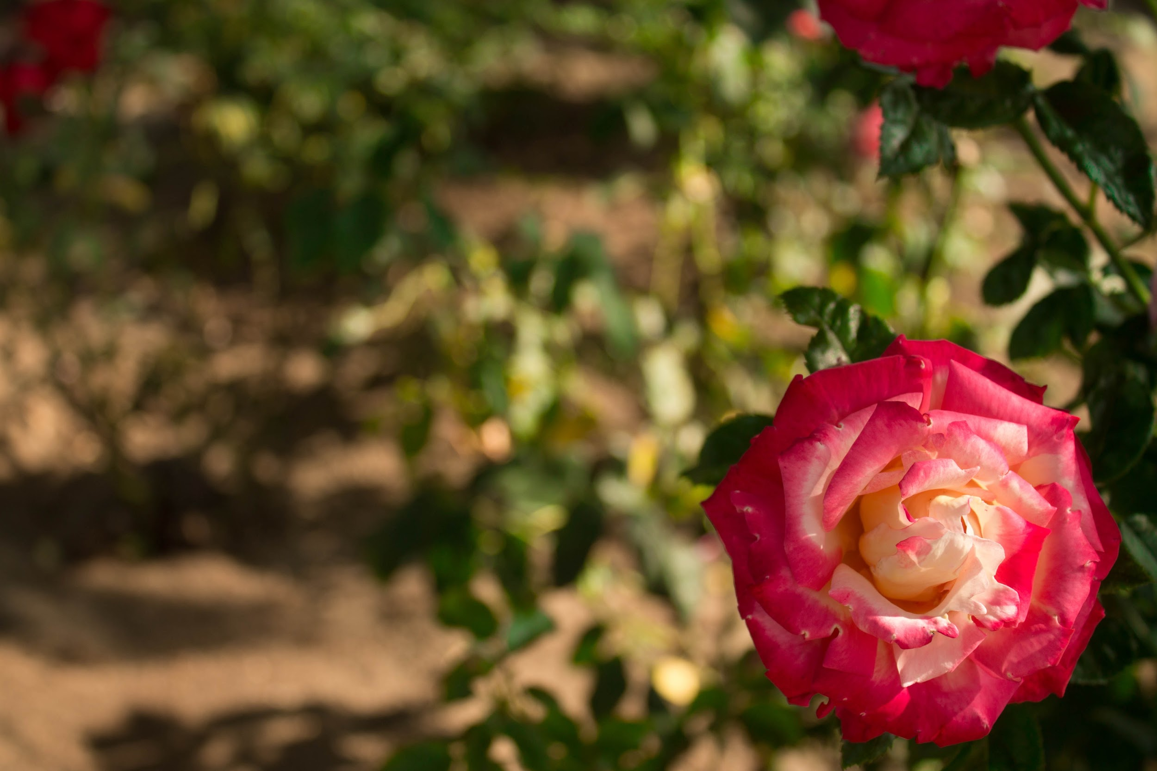
Shallow Depth of Field

Slide 9
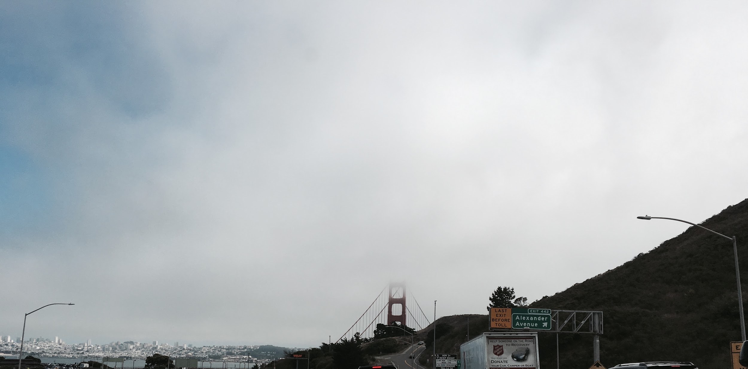
Deep Depth of Field

Slide 10
5 Images That Draw Inspiration From Class
Ansel Adams B&W Meets Industrialization/Human Progress Themes

Slide 11
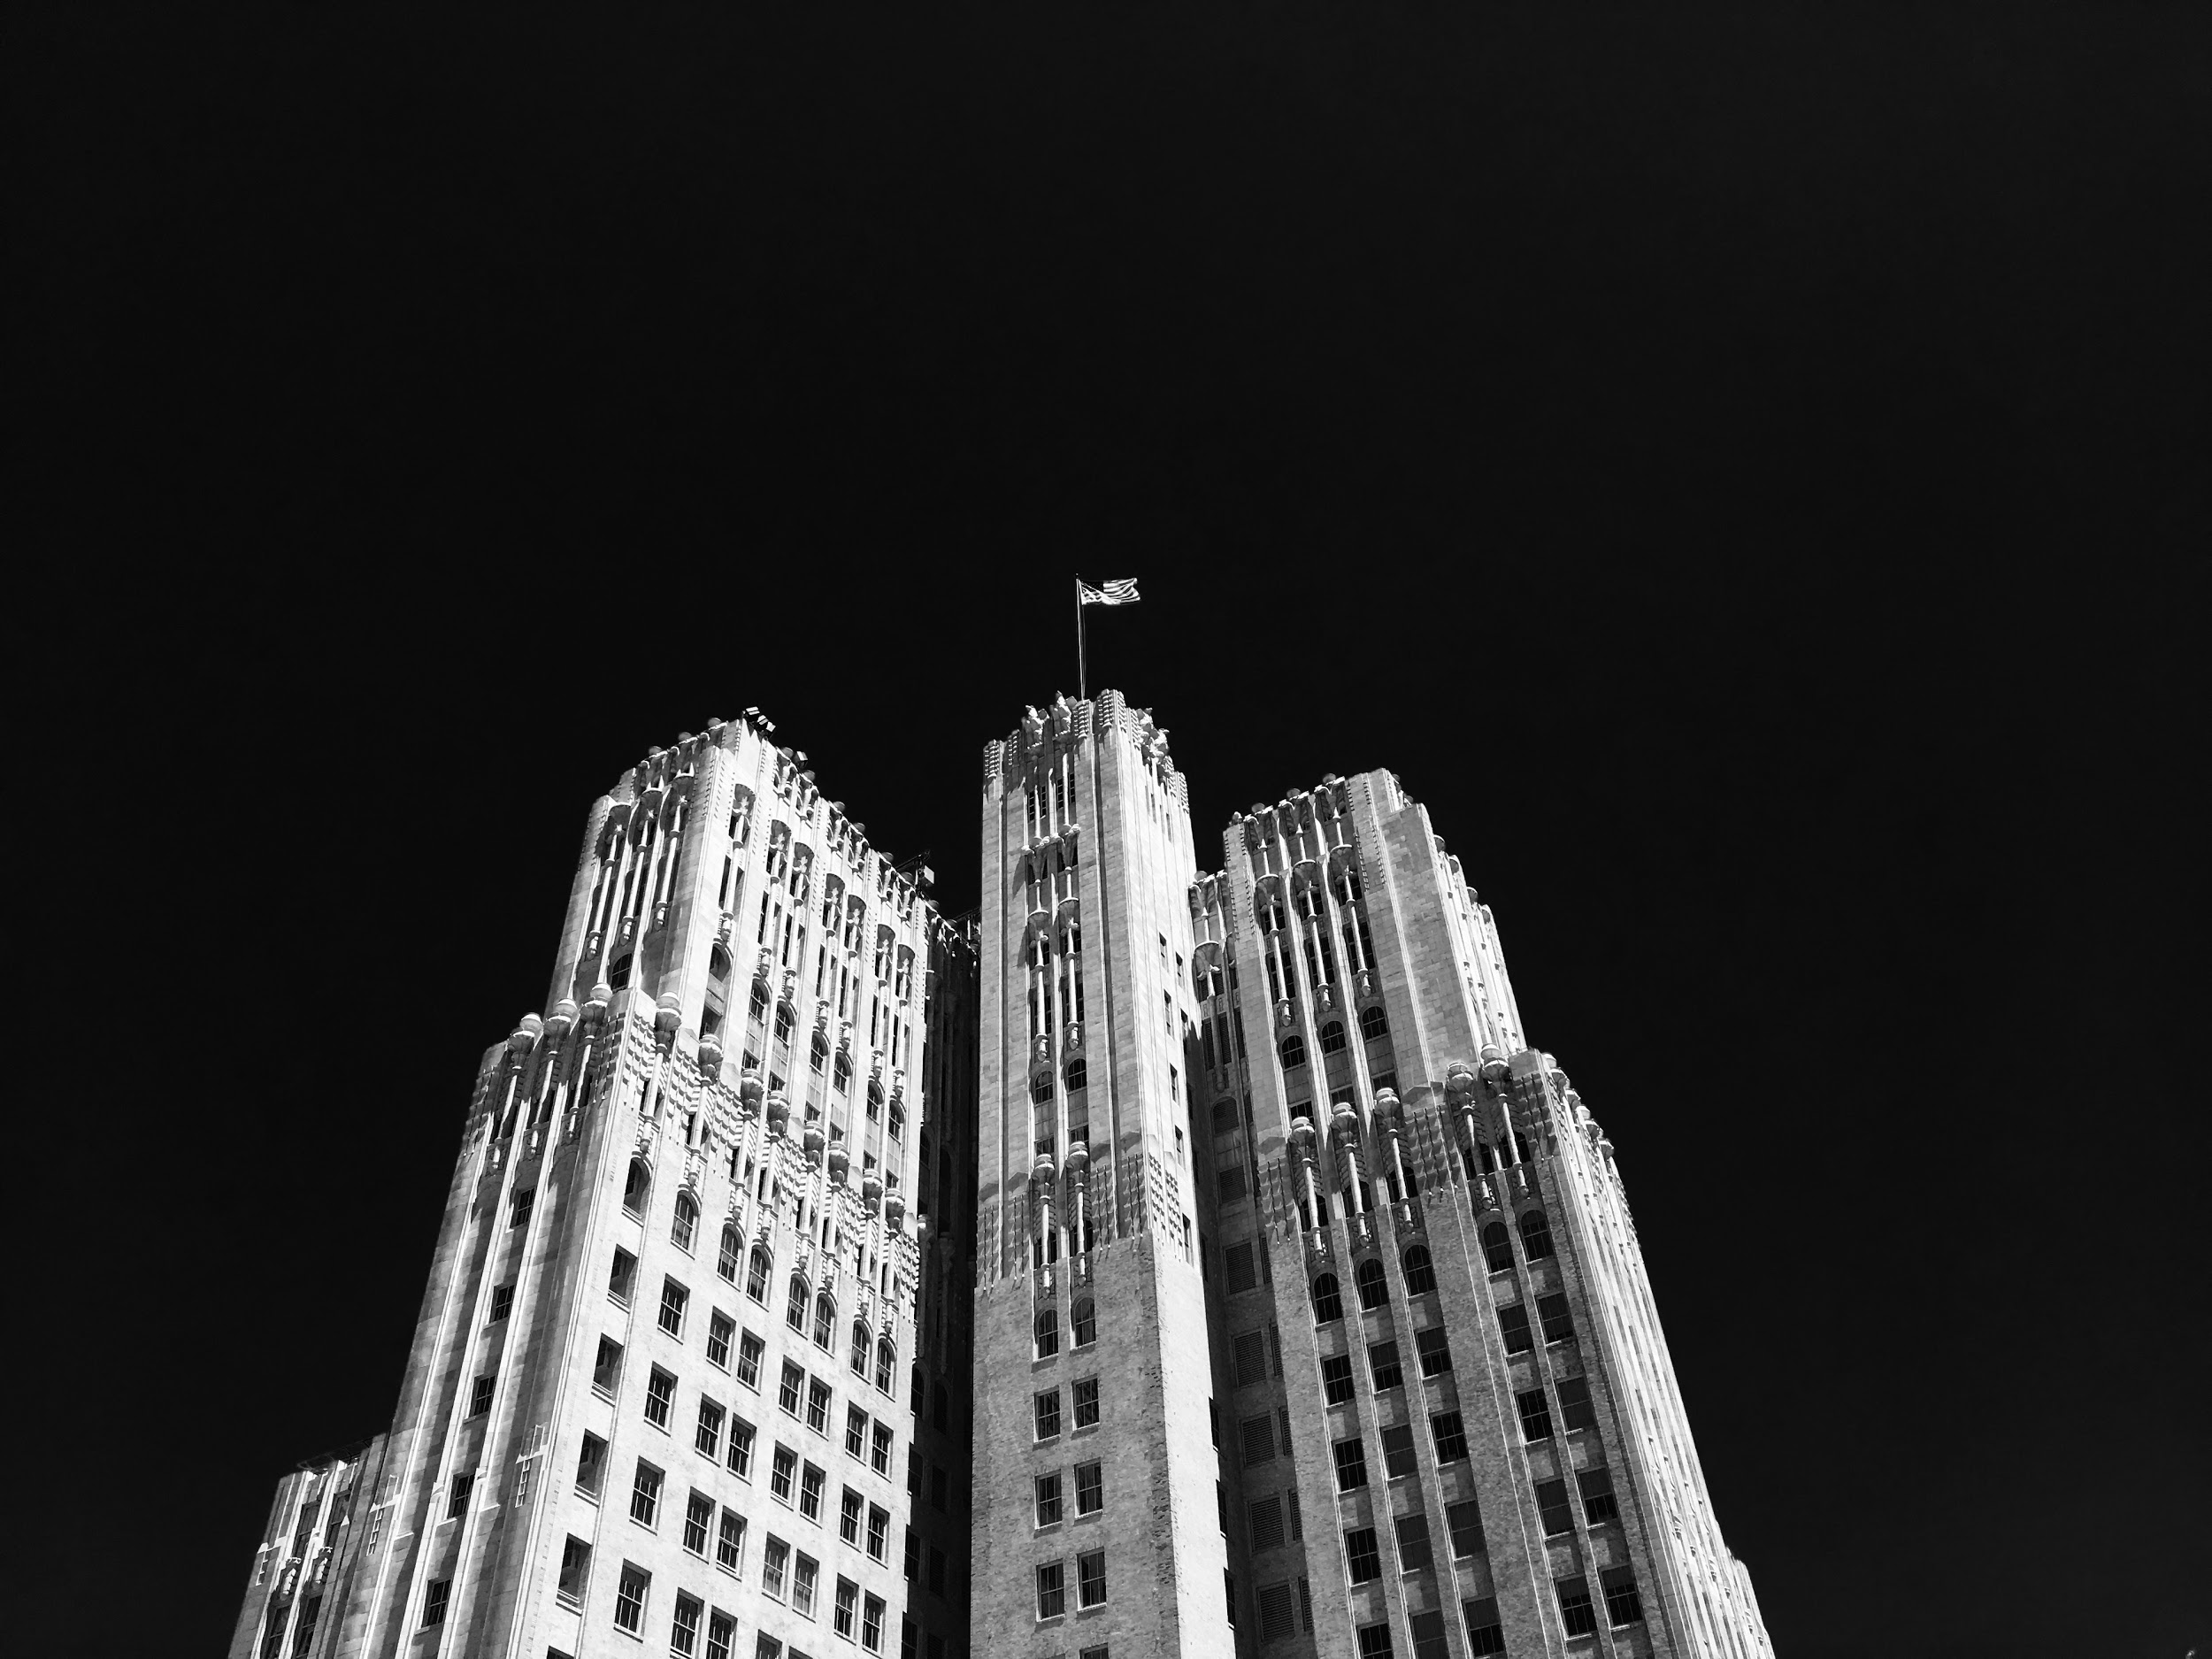

Slide 12
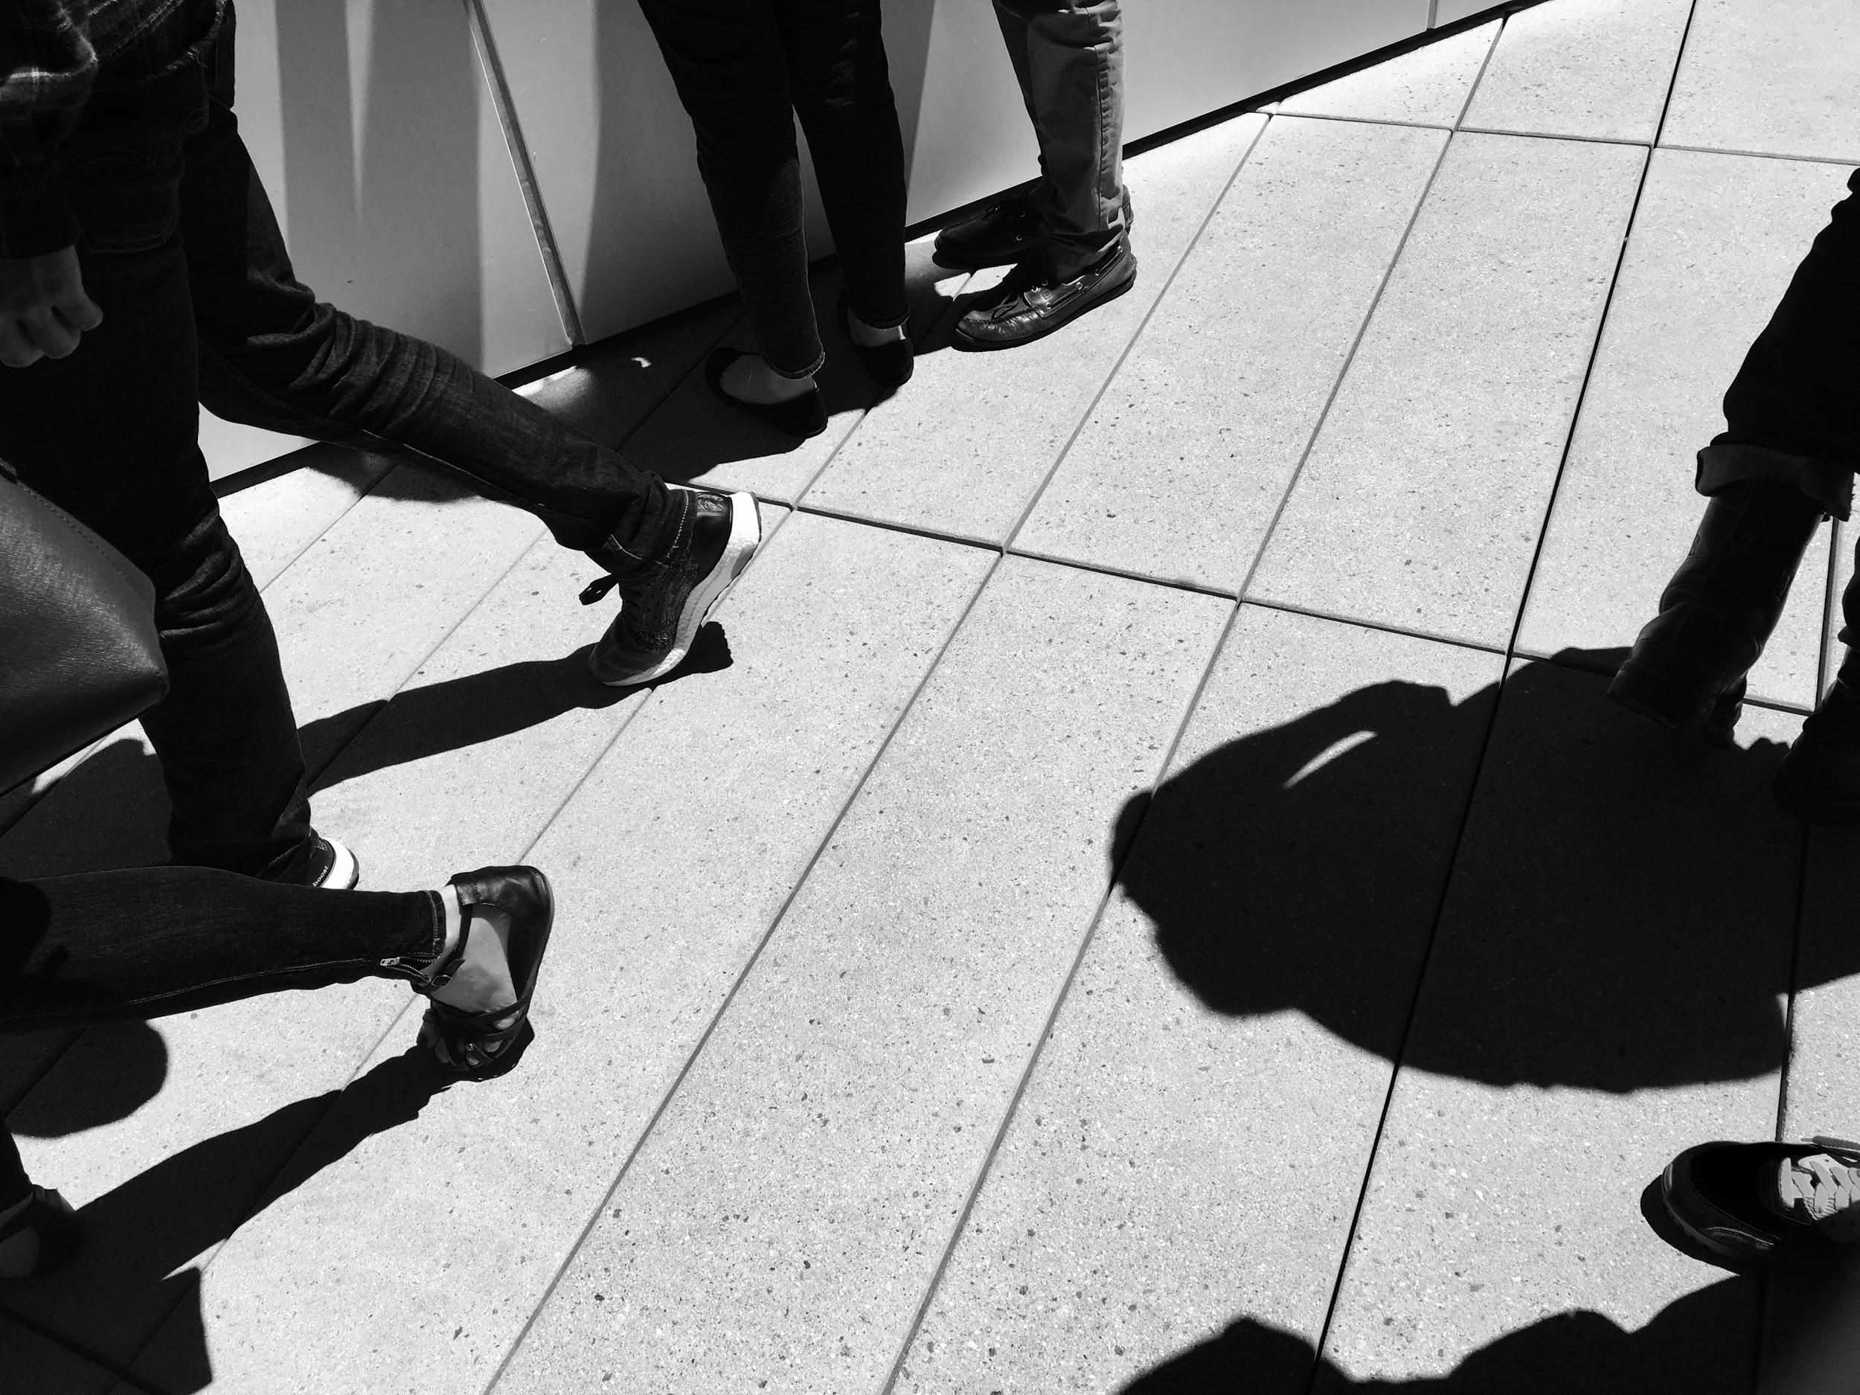

Slide 13
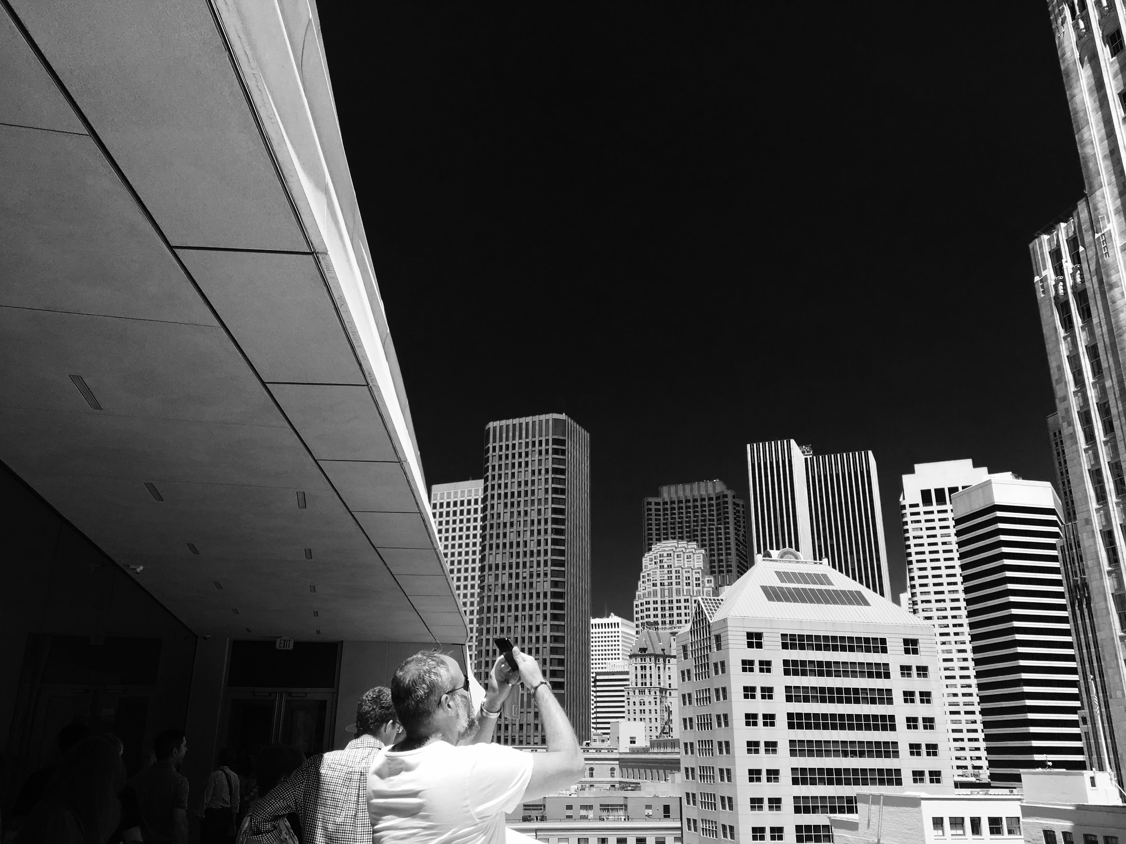

Slide 14
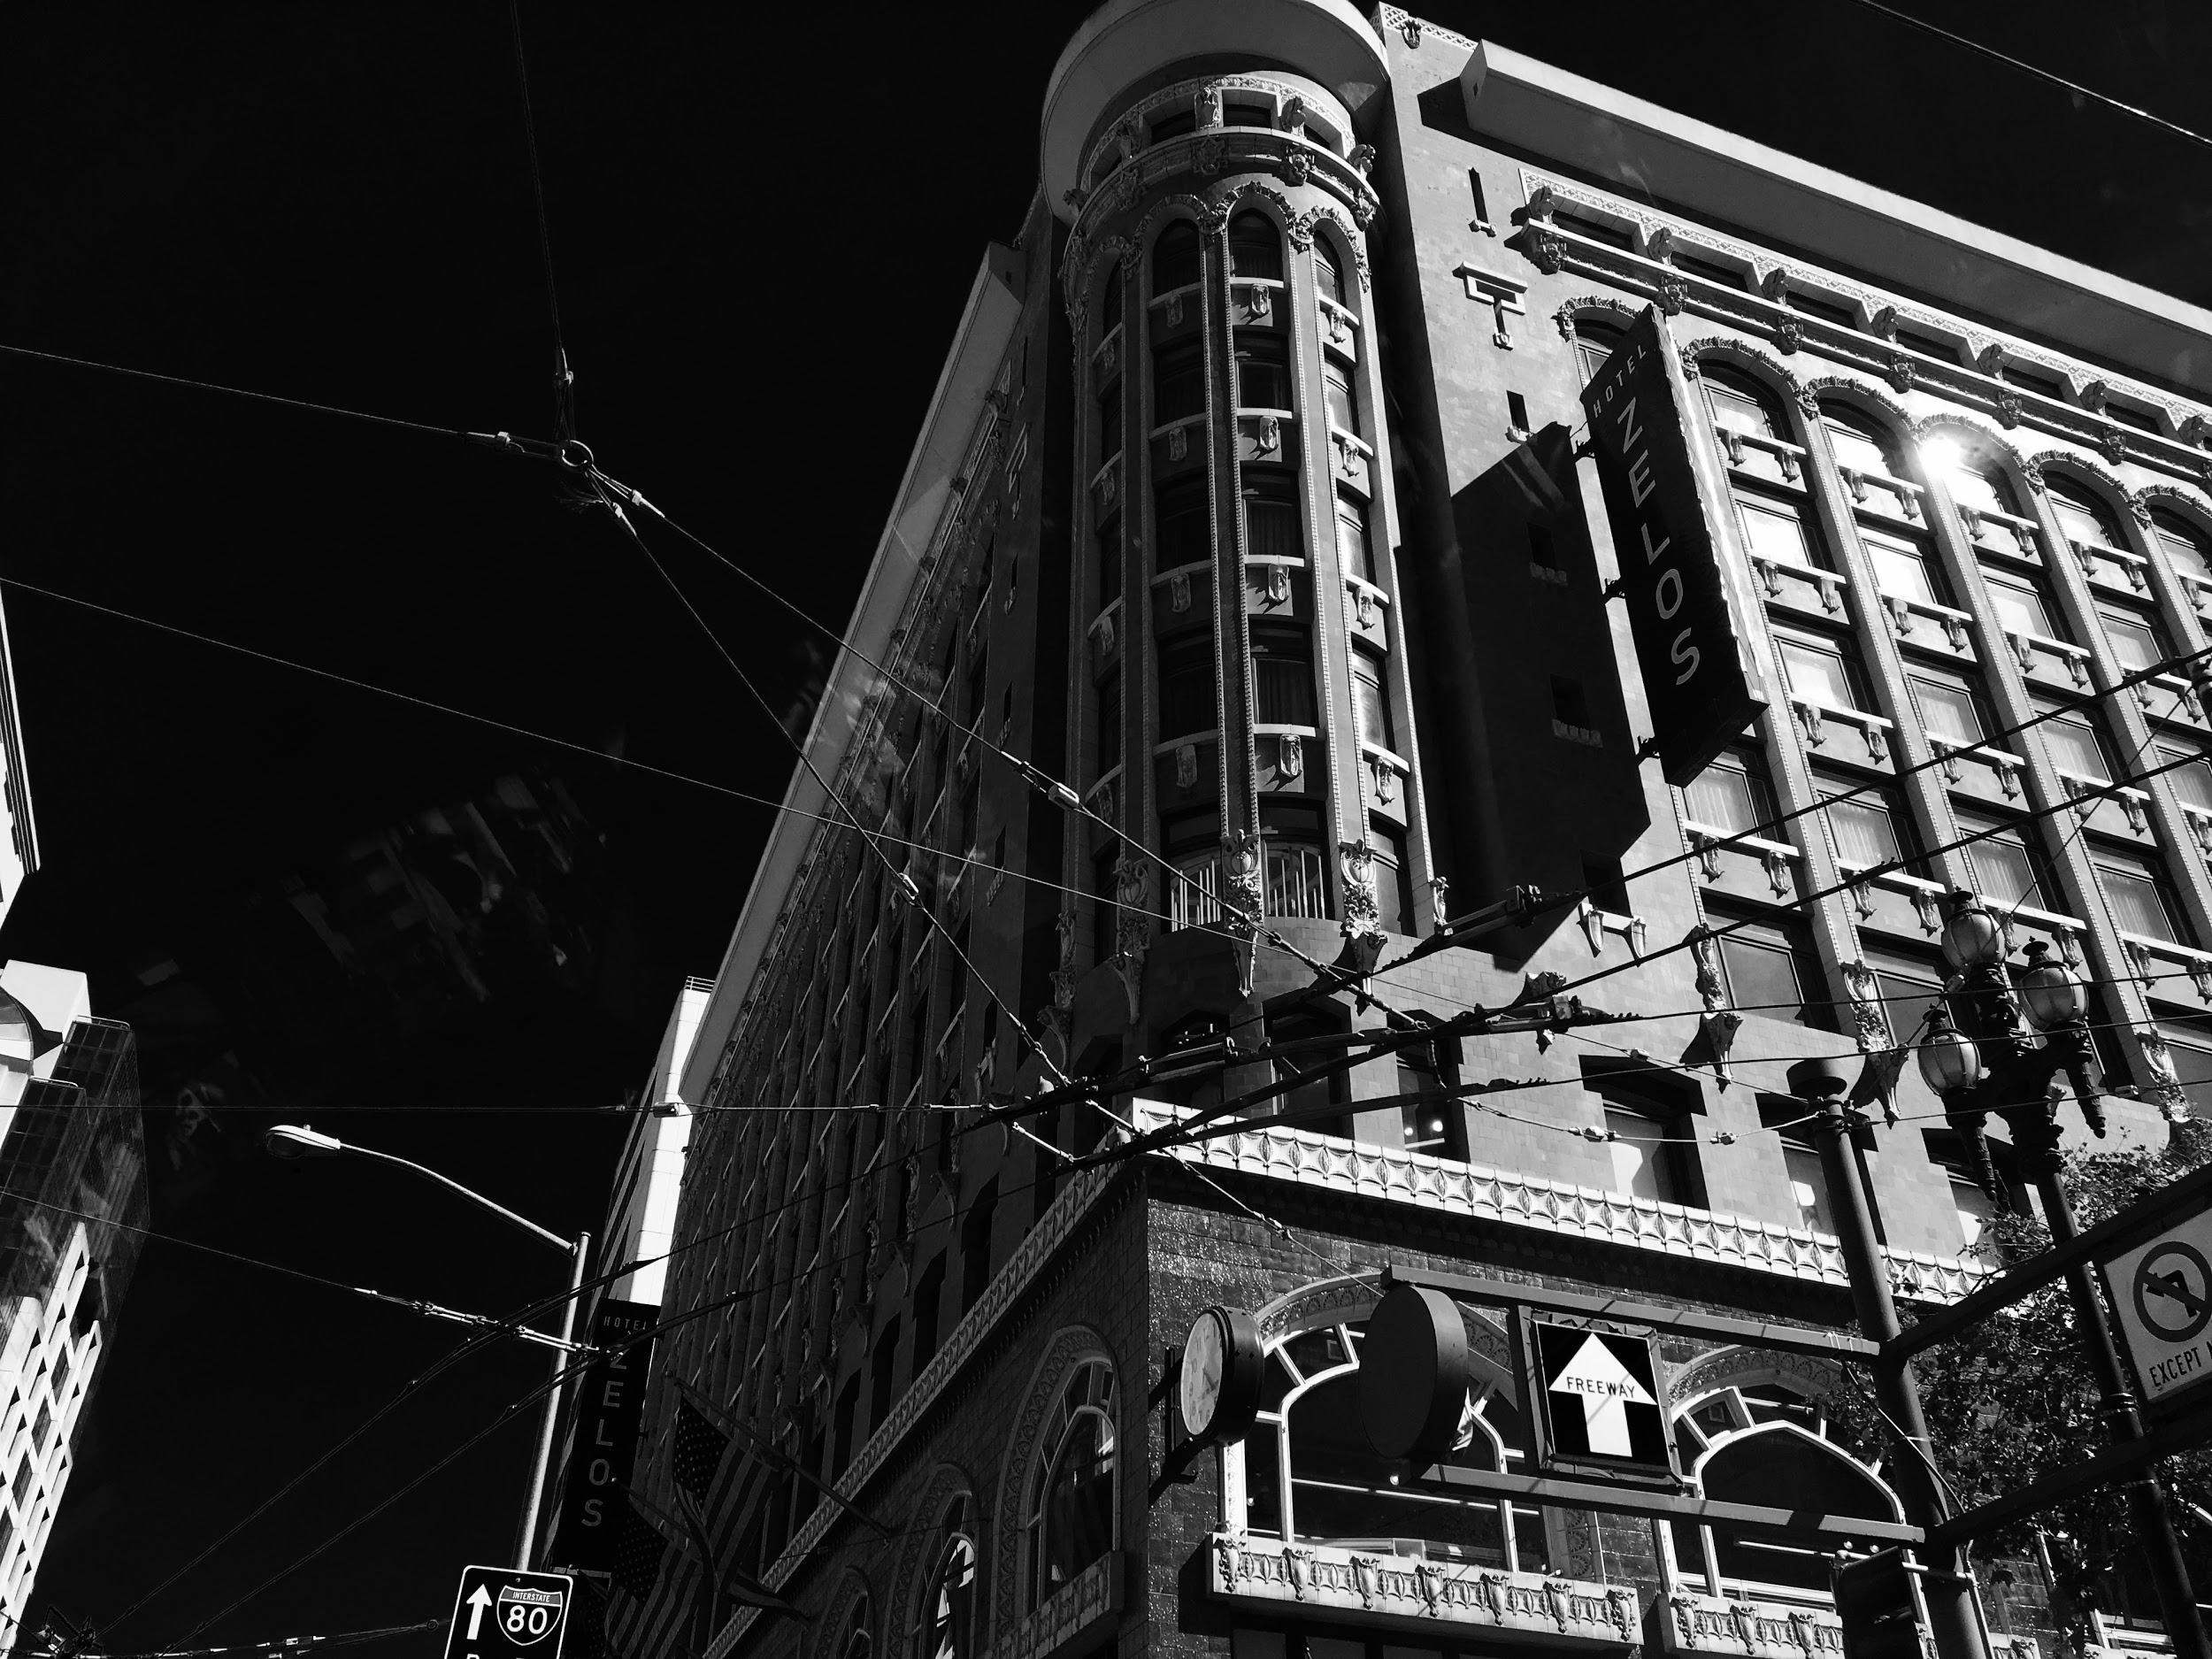

Slide 15
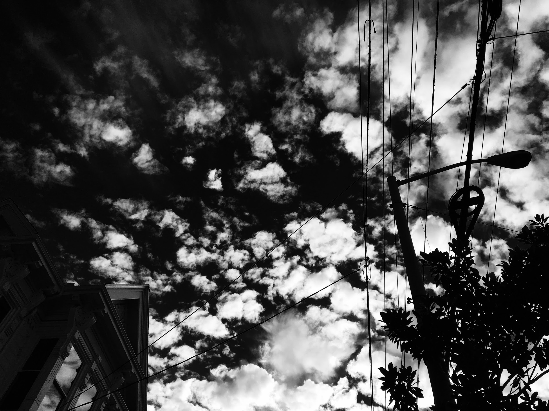

Slide 16
Three Terrible Titles

Slide 17
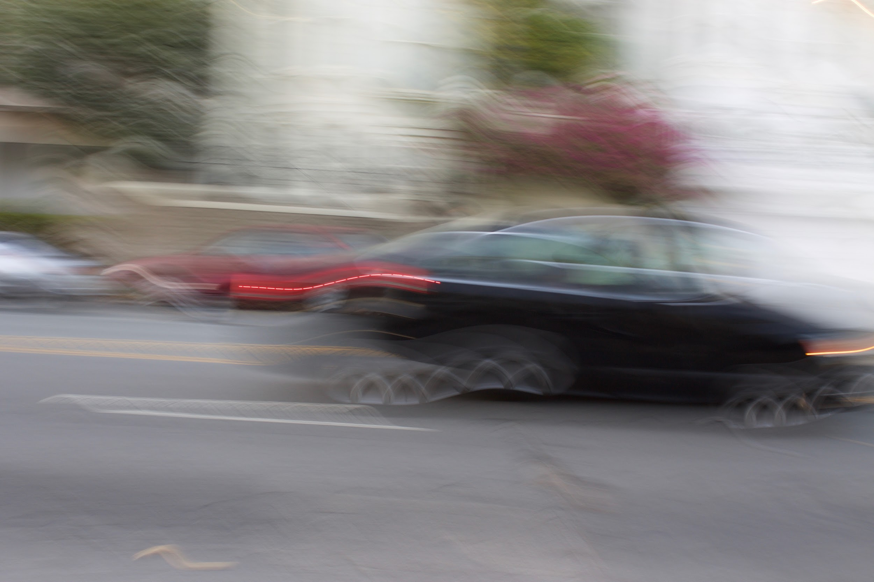
A Land of Rest and Relaxation ...

Slide 18
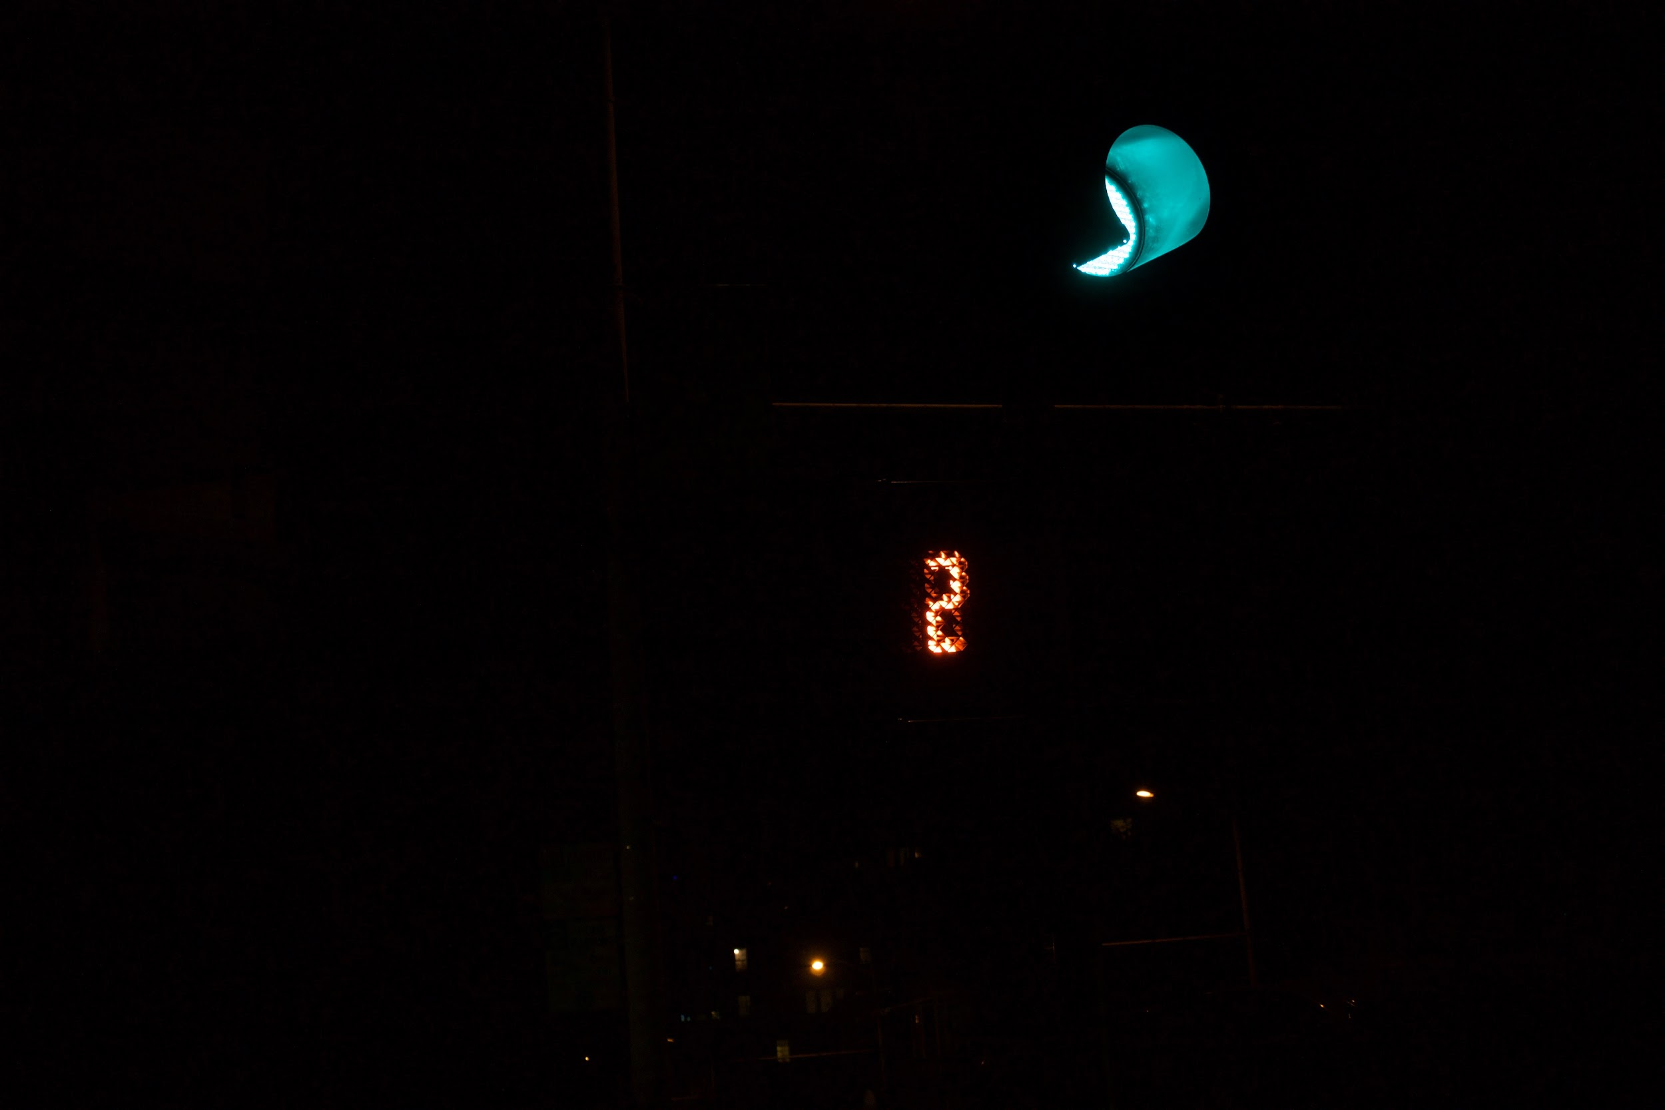
… where you can progress at your own pace ...

Slide 19
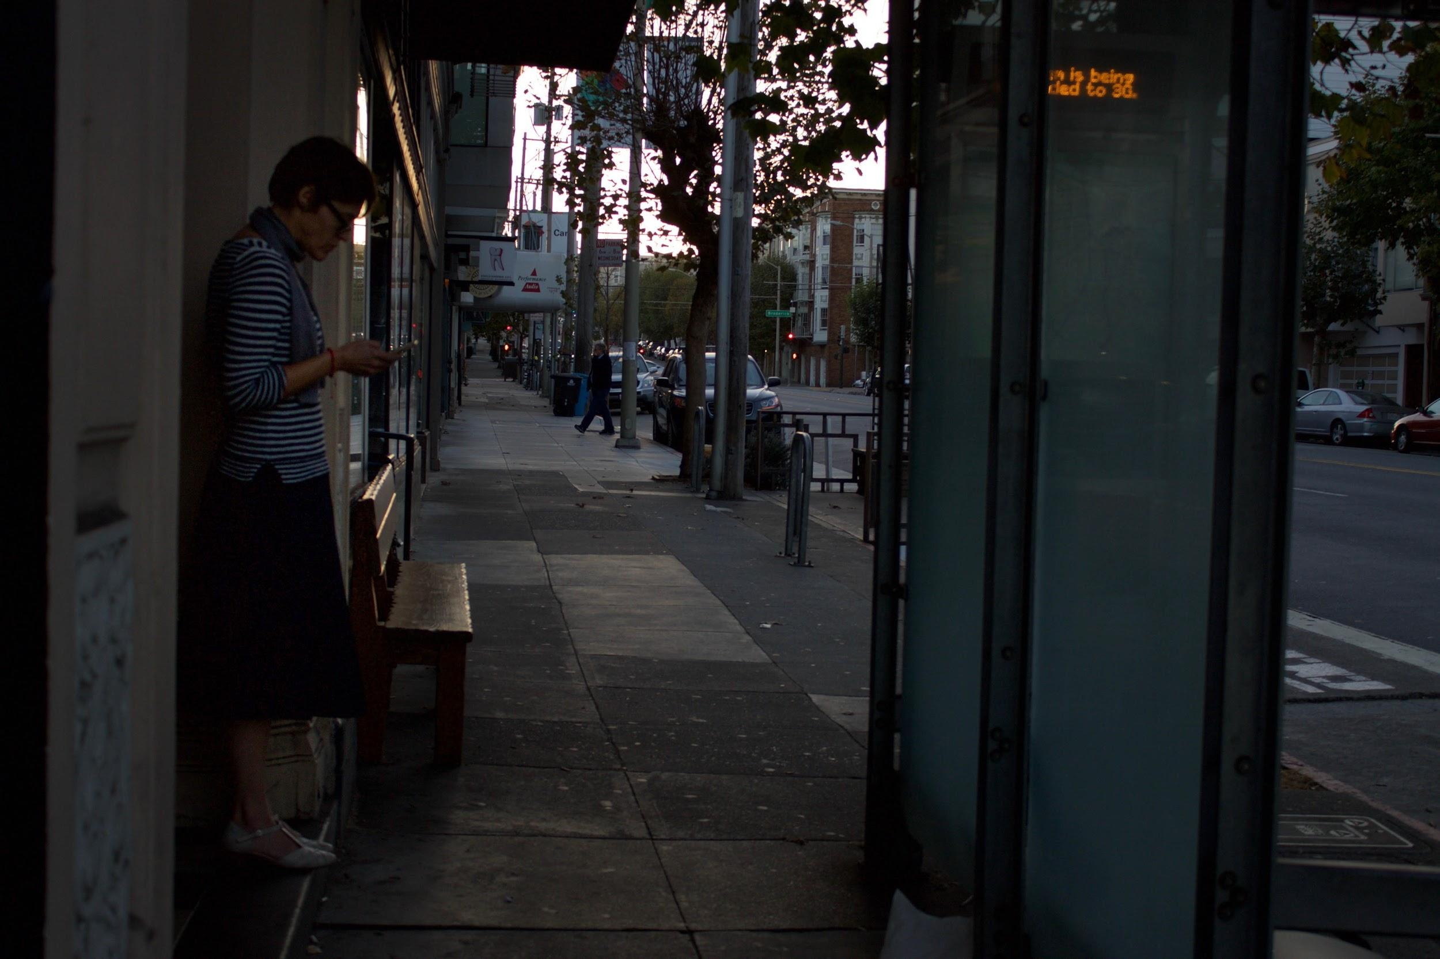
… The Land of The Free.

Slide 20
Thank You

